Slide 1
SE WEBSITE
Test Findings
INITIAL SITE REFRESH WIREFRAME TESTING

Slide 2
Recruitment & Methodology
Purpose
To improve understanding of what our customers want from SE and our websites
To perform usability testing on a Scottish Enterprise website wireframe prototype, to validate initial concepts for future state layout/design.
To inform the next design iteration
Location
Taylor McKenzie test lab in Glasgow (6 & 14 March)
Sample
Number: 12 customers (potentially eligible for SE services)
Country: Scotland
Device: Desktop
Type: Face to Face testing
Customer Profile: Scottish companies, non retail, turnover > 500K and not currently receiving support from us

Slide 3
What we Did
We explored:
What services the user would expect Scottish Enterprise to offer?
What information the user would come to the Scottish Enterprise website to find?
What actions the user would expect to be able to perform on the Scottish Enterprise website?
We then asked users to view the prototype so that we could test specific journeys.

Slide 4
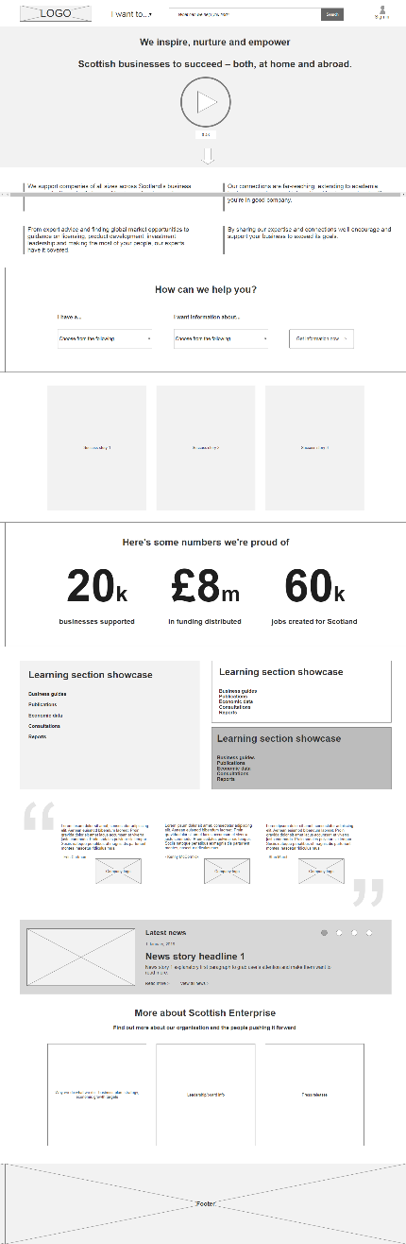
Research: Home page

Slide 5
What we Did
We captured:
What they were thinking
What they did
How they felt

Slide 6
Research: Home page
☺
☹
Everyone clicked on the video
“I Want To” menu was almost totally ignored
These statements got in the way of the next section
Most people gravitated towards this
Well received
The STAT’s were very well received, although authenticity was questioned
Not well understood or received
Well received
Mild praise but not warmly received
Most users viewed this as overkill on a home page

Slide 7
Themes
GENERAL
REQUESTING CUSTOMER DETAILS
COMMUNICATION
INFORMATION & CONTENT
LAYOUT & DESIGN

Slide 8
Themes
General
Customers confused where to go for the right information
Customers often unsure of which organisation they are dealing with
Customers unclear why they get grant/support rejected
Requesting Customer Details
Don’t ask for too much information too early in the journey (eg high degree of surprise in asking for Companies House information)
Belief that inputting details would result in “being marketed to”
Communication
Majority of users preferred telephone number to call if they got stuck
Live Chat mixed reviews
Businesses are interested in help from organisations (such as SE) BUT only if it is relevant to them

Slide 9
Themes
Information
Language needs to be clear
The journey to get to relevant information should be simple and quick
Large and impressive Stats are popular (but users questioned if they were real)
Information ”Below the Fold” remains a very real barrier to some users seeing the actual CTA’s
Content
Users expect most things to be clickable
Users expect interaction to be quick so indicated time it takes seen as irrelevant
The “Search Bar” was used as the preferred bailout method, when the user struggled to find what they were looking for
Menu Options were well received (though sometimes missed initially)
Too much content not well received (eg Learning/Development section showcase because not relevant to them at this time)
Case Studies are good but need to be directed to me and my sector
Layout
Sticky footers not well received
Pop ups not liked (and mostly clicked away from without reading)
Design
Users wanted the home button to be named as such (rather than logo click)

Slide 10
Themes
Layout
Sticky footers not well received
Pop ups not liked (and mostly clicked away from without reading)
Design
Users wanted the home button to be named as such (rather than logo click)

Slide 11
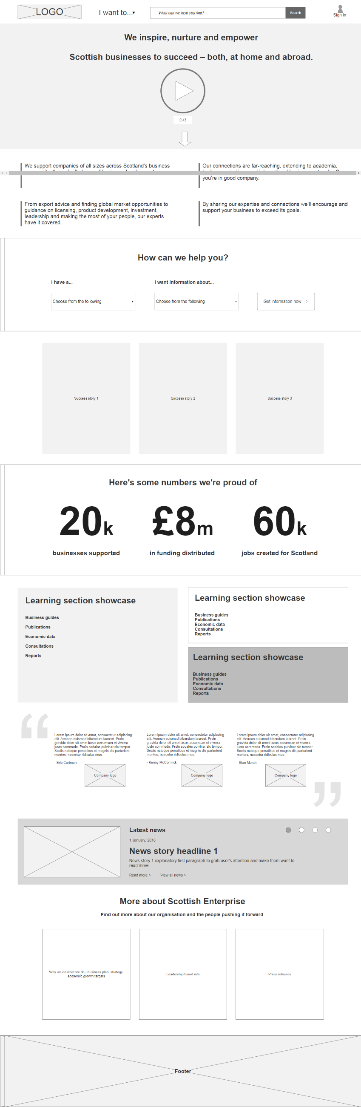
Recommendation: Home Page
Redesign Menu and Search box
Simplify
Homepage

Slide 12
Quotes
I don’t want an account at this stage. I am only making an enquiry”
“I would apply online as long as the form is not 10 pages long”
“I just wouldn’t scroll”
““I love things on the internet that are simple such as HMRC”
““I am not in that category anymore so I am not sure how you can help me”
“The Stats look Great – are they real?”
“FAQ’s were cool” in the live chat box.

Slide 13
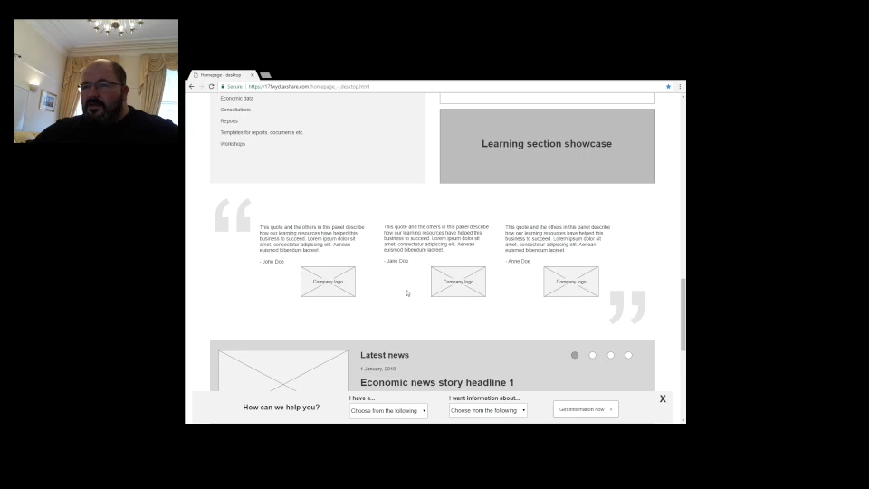
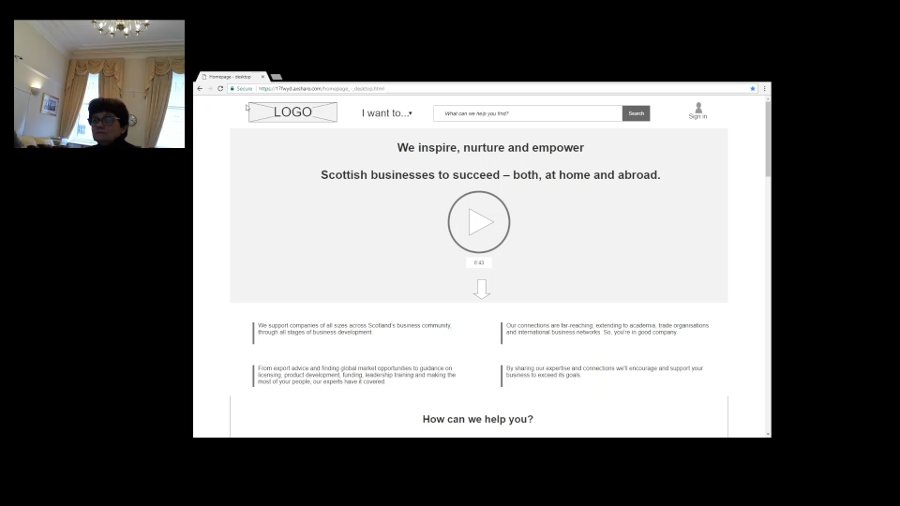

Videos: Standout quotes
1. I just wouldn’t scroll
2. I thought that was to do with the Search Box

Slide 14
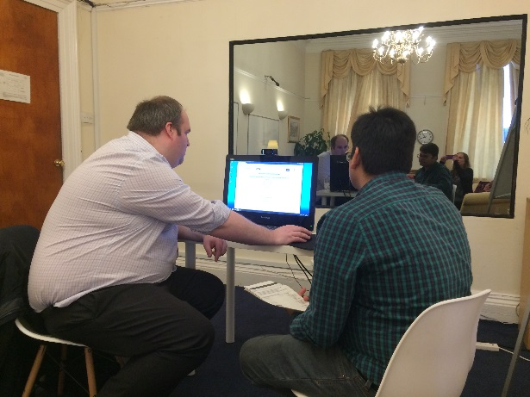
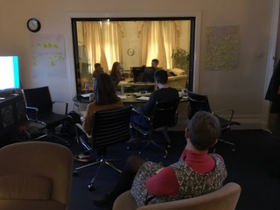
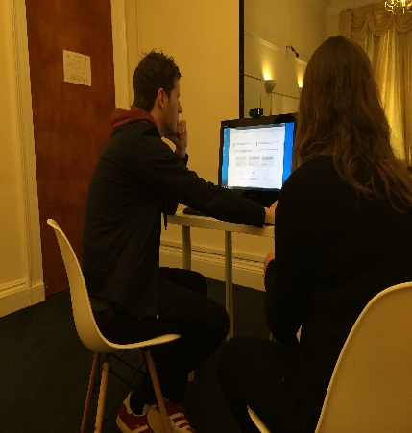
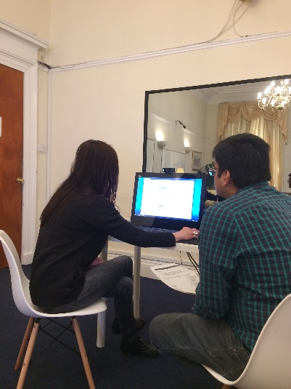
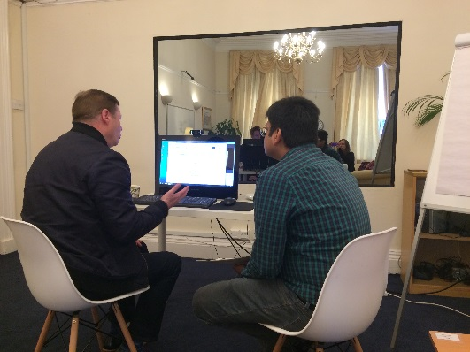
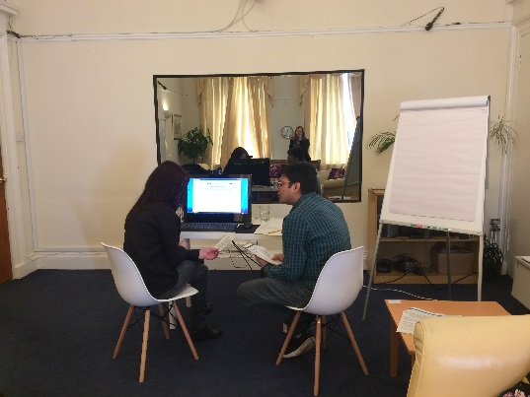
The Team in Action

